Slide 1
BITCOIN PRICE PREDICTION
TEAM MEMBERS:
JANAPATI SARATH CHANDRA-20BCE1138
GUGGILAM AMARNATH-20BCE1543
ASHWIN K S – 20BCE1733

Slide 2
ABSTRACT
In this project, we are going to predict the price of bitcoin with maximum possible accuracy taking into consideration of various parameters that are affecting the price of bitcoin day by day.
We have used different machine learning algorithms in our work to predict the future prices of the bitcoin . The algorithms used are: ARIMA, Facebook’s Prophet, Support vector machine (SVM),ridge regression, regression.

Slide 3
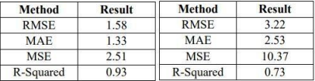
MOTIVATION
The ARIMA and PROPHET packages in R were found to be quite important factors for the job at hand.
While the PROPHET model that we are using makes predictions quite close to reality, that is it can make up to 94.5% precision and the ARIMA model provided only 68% precision.
In the given below tables first is for support vector machine and second for linear regression which clearly says support vector machine is much better than linear regression

Slide 4
OBJECTIVE
This project deal ever changing price of bitcoins or in general cryptocurrency. This can be seen in recent years when practically non existing cryptocurrency like dogecoin by some tweets from Elon Musk sore higher prices.
Bitcoin is the world’s leading crypto currency, allowing users to make transactions securely and anonymously over the Internet.
In our work we are going to focus mainly on Bitcoin which s most popular among the virtual currencies and has a great acceptance by different bodies like investors etc. So, in this project we will perform different prediction algorithms on bitcoin data and find which one is performing better.

Slide 5
EXISTING SYSTEM
Normally, We have implemented the general machine learning algorithms like SVM, Arima, Regression models to predict the prices of a bitcoin. We have mentioned the above discussed models in our project in order to compare the accuracy of the new model we have implemented in our project.

Slide 6
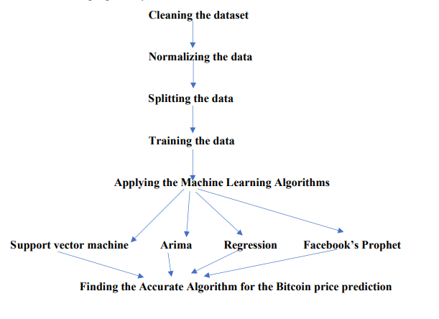
ARCHITECTURE OF PROPOSED SYSTEM

Slide 7
MODULE DESCRIPTION
Data Preprocessing Module: This module is responsible for collecting and preprocessing the data required for Bitcoin prediction. It includes tasks such as data cleaning , normalizing , splitting and training the data . This module prepares the data for use in the machine learning models.
Model selection and training Module:
Here we are going to apply machine learning algorithms like support vector machine ,arima , facebook’s prophet ,ridge regression and regression for the dataset and we are going to train the models on the preprocessed data.It involves tasks such as selecting the training algorithm, splitting the data into training and validation sets, and adjusting the model's parameters to optimize its performance.

Slide 8
Finding the accurate algorithm for the bitcoin price prediction:
By finding the accuracy of the machine learning algorithms , we are going to find which algorithm has more accuracy and fit for bitcoin price prediction
Model Evaluation Module: This module is responsible for evaluating the performance of the trained machine learning model on the validation data. It involves tasks such as computing various evaluation metrics, such as accuracy, precision.

Slide 9

ALGORITHMS:
FACEBOOK PROPHET:
The trends nowadays are nonlinear and changes day to day basis. So, to forecast this change which happening in time series, the Facebook prophet is the best choice. This prophet deals the outliers well and the robustness the missing data to trends.

Slide 10

ARIMA:(Autoregressive integrated moving average)
Arima explains a given time series based on its own past data which is lagged of its forecast errors. ARIMA, is a statistical analysis model that uses time series data to better understand a set of data or predict future trends. The mathematical model is autoregressive when predicting future values based on past values.
SUPPORT VECTOR MACHINE:
Generally, it is used for predictive analysis which assigns new data elements to one of labelled categories in data we are performing.It is combination of supervised learning methods used for classification of data regression analysis and detecting outliers of data.

Slide 11
REGRESSION:
Generally, for better data analytics we need to determine the strength and character of the relationship between one dependent variables. So this can be performed by the regression. Regression can value assets and tells us commodity prices.
RIDGE REGRESSION:
It is a method of estimating the coefficients of multiple-regression models in scenarios where impartial variables are relatively correlated.

Slide 12
IMPLEMENTATION
Models we taken:
• Assigning model1 for low and high
• Assigning model2 for open and close
• Assigning model3 for date and open

Slide 13
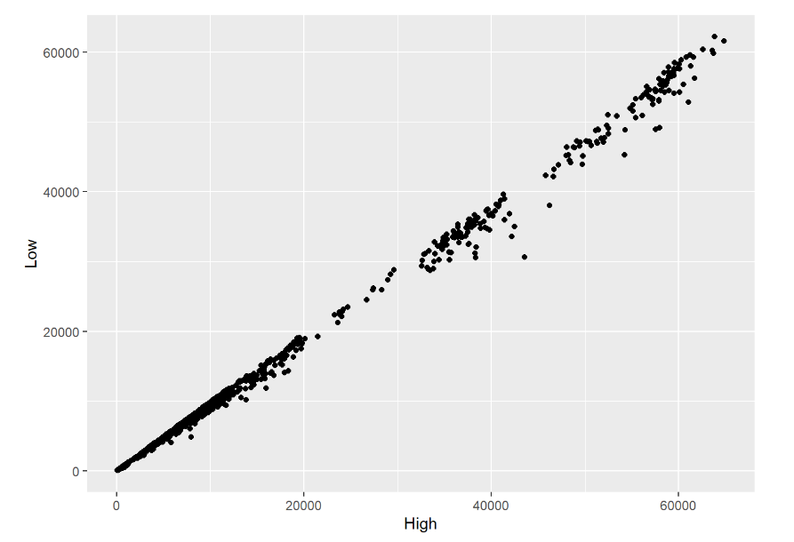
DATA VISUALIZATION

Slide 14
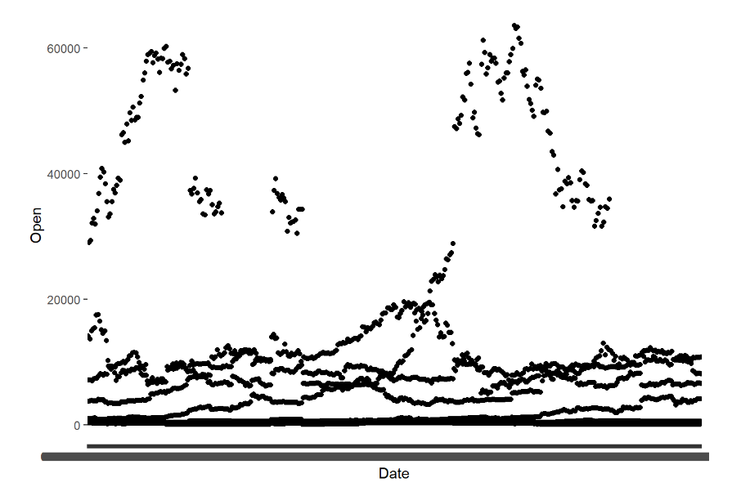

Slide 15
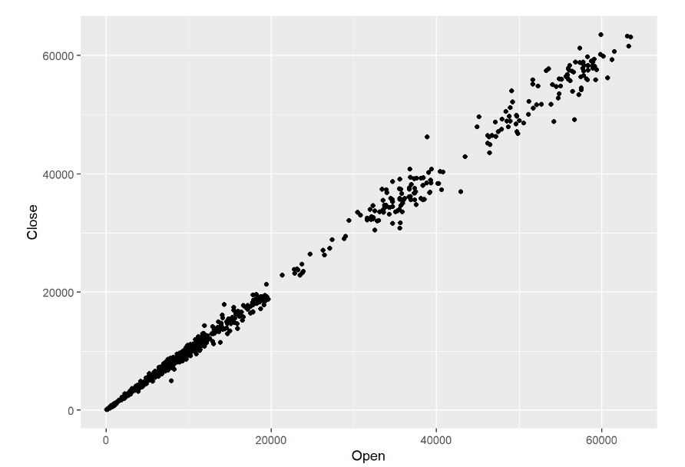

Slide 16
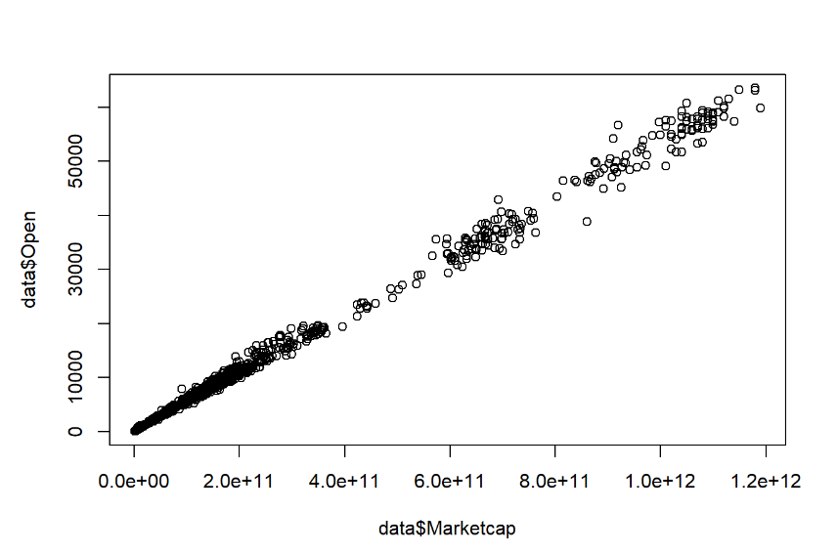

Slide 17
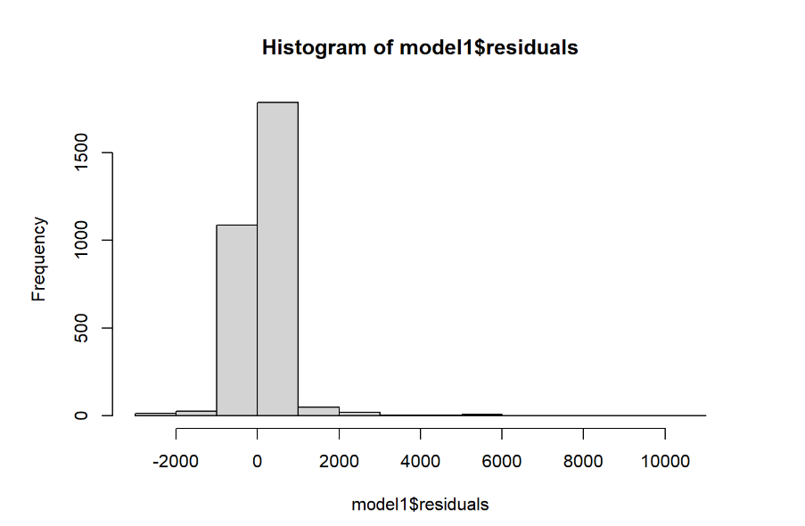

Slide 18
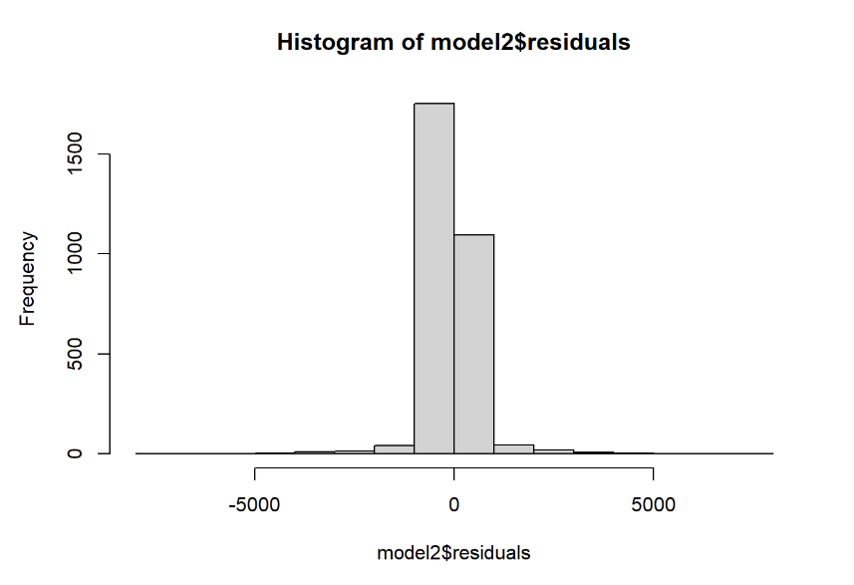

Slide 19
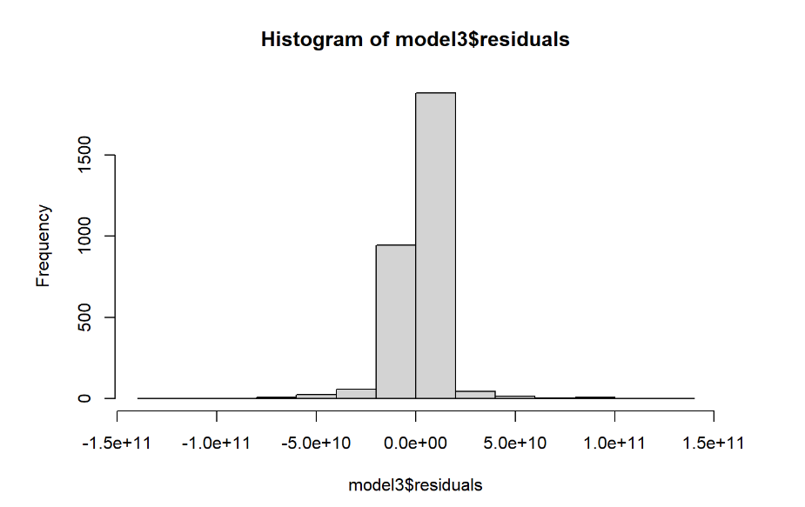

Slide 20
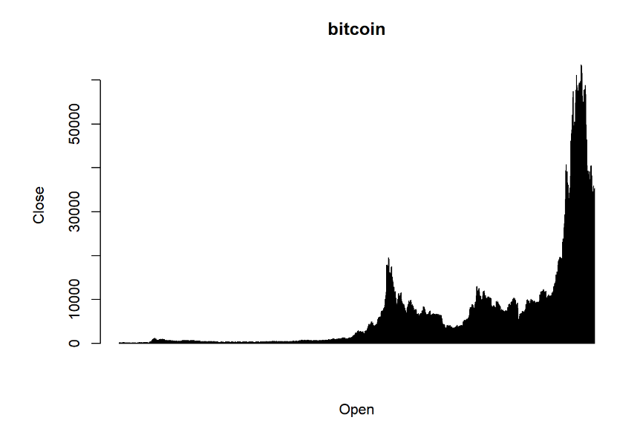

Slide 21
REFERENCES
Bitcoin Price Prediction and Analysis Using Deep Learning Models :Temesgen Awoke, Minakshi Rout, Lipika Mohanty, and Suresh Chandra Satapathy (LINK)
Bitcoin Forecasting Using ARIMA and PROPHETIs ¸ ıl Yenido˘gan, Aykut C¸ ayırMIS DepartmentKadir Has University, Istanbul, Turkey{isil.yenidogan, aykut.cayir}@khas.edu.trOzan Kozan, Tu˘gceDa˘g, C¸ i˘gdem Arslan MIS Department Kadir Has University, Istanbul, Turkey{sukruozan.kozan, tugce.dag,cigdem.arslan}@stu.khas.edu.tr(LINK)
A Comparative Study of Bitcoin Price Prediction Using Deep Learning Suhwan Ji, Jong min Kim and Hyeon seung Im (LINK)
Predicting Stock Market Price: A Logical Strategy using Deep Learning Milon Biswas Computer Science and Engineering Bangladesh University of Business and Technology, Dhaka, Bangladeshmilonbiswas4702@gmail.comAtanu 5. Garcia, D. & Schweitzer, F. (2015). Social signals and algorithmic trading of Bitcoin. Royal Society Open Science 2(9), 150288. Retrieved from https://dx.doi.org/10.1098/rsos.150288 10.1098/rsos.150288
Kathyayini, R. S., Jyothi, D. G. & Crypto, ”. Currency Price Prediction using Machine Learning”. International Journal of Advanced Research in Computer and Communication Engineering. 7. Nakamoto, S. & Shah, ;. D. (2017). Trading Bitcoin and Online Time Series Prediction. NIPS 2016 Time Series Workshop . 8. Santhosh, &., S. G. & ”. A Relative Study on Bitcoin Mining. Relative Study on Bitcoin Mining”, Imperial Journal of Interdisciplinary Research

